Slide 1




Apache Footwear India Private Limited
The Prototype for
Cutting Material Management
Report Presented
Presented by : Manohar-G ( APC-IT )
2025 July 10

Slide 2

Organizational Workflow for Cutting Material Monitoring
Data Capture
BOM
Provides base material requirements.
Cutting Material Report
Input purchase data
Issue materials, verify stock
Purchase Team
Warehouse Team
Track Purchase Status
Warehouse stock data
Production
Check assigned POs start cutting only if fully ready escalate
Ensure BOM is accurate
validate material need
resolve errors
Track PO-wise readiness
material issues
escalate to teams
Planning Team
Plant In-charge
Line Supervisor
shares
Assigns
Top
Management
Sees high-level overview
View overall readiness %
material trends
escalations
Top Management
Cutting Material Report auto-syncs BOM,PURCHASE, WAREHOUSE, PLANNING AND PO DATA| Triggers alerts and tracks material readiness

Slide 3

Key Responsibilities For Cutting Material Management Report
BOM Department – Enhancing Accuracy and Efficiency :
1 . Ensure Accuracy in BOM Pulling
2 . Create BOM Based on Actual Article Usage 3 . Avoid Unnecessary Material Creation
Pull BOM
Purchase Department – Ensuring Timely and Aligned Procurement
Procure Based on Finalized BOM Requirements
Monitor Material Lead Times Proactively
Avoid Over-Purchasing or Excess Inventory
Purchase Department
Warehouse Department – Maintaining Data Accuracy and Stock Readiness
Ensure Accurate Stock Data Maintenance
Fetch and Share Stock Data Correctly
Support Cutting Material Availability Checks
Warehouse Department
Planning Department – Driving Accurate Schedules and Coordination
Maintain Accurate Planning Data
Update Schedules Promptly
Coordinate Closely with Other Departments
Escalate Issues Proactively
Planning Department
Production Department – Ensuring Smooth Execution and Timely Output
Follow Updated Cutting and Production Plans
Communicate Line Stoppages Immediately
Track and Share Real-Time Progress
Production

Slide 4

Cutting Material Availability – Line Supervisor
Day
PO NO
2025/07/05
All
Status
Line
All
All
📋 Assigned Pos
5
✅ Ready to Cutting
3
❌ Not Ready
1
⚠ Escalated
1
PO Readiness List
Day | Line | PO NO | Article | Material Status
2025/07/05 | AP11CO5 | 1000042525 | Samba | ✅ OK
 |  | 1000042579 | Samba | ❌ Short
Check
Check
Material Checklist by PO
PO NO
By default the field takes short material status po in ascending order
1000042579
PO NO | Article | Material | Material Name | Required Qty | Available Qty | Shortage Qty | Status | Invoice | ETA
1000206709 | Samba | M001 | Material 1 | 125 | 125 | 0 | ✅ OK
1000206709 | Samba | M002 | Material 2 | 520 | 300 | 220 | ❌ Short | INV-MAT-20240620-0048 | 2025/07/05
Raise Escalations
PO NO
1000042579
Issue
Submit
Enter Issue
Request store verification
PO NO
Check
1000042579

Slide 5
Cutting Material Availability – Plant In-charge Dashboard
Date Range
Line
PO NO
2025/07/01
All
Plant
All
All
Status
All
📋 Total POs Today
28
✅ Fully Ready Pos
19
🚫 Shortage Pos
7
🔁 Delayed Pos
2
PO-Wise Material Readiness Status
Date | PO NO | Model | Plant | Line | Material Readiness % | Status | Delay | Action
2025/07/02 | 1000042579 | SAMBA | AP11 | AP11C02 | 100% | ✅ Ready | - | Start Cutting
 | 1000042525 | STANSMITH | AP10 | AP10C04 | 75% | ❌ Short | 1 DAY | Escalate
 | 1000215486 | ULTIMATE | AP09 | AP09CO3 | 90% | ⚠ Partial
Check
Material Shortage Tracker
Material Name | Required Qty | Available Qty | Short Qty
Fabric A | 200m | 160m | 40m
Purpose: Core operational view—monitor each PO’s readiness at the line level and Material-wise breakdown of what’s short and how many POs are impacted..
Benefits : Take immediate steps for POs with issues and Communicate to purchase team or prioritize allocation from existing stock.

Slide 6
Cutting Material Availability Dashboard – Plant In-charge Dashboard
Critical Escalated Pos :
PO NO
Plant
Status
All
All
All
Submit
PO NO | Plant | Shortage | Delay | Escalated To | Status
1000042525 | Plant B | Fabric A | 3d | Planning Team | ⚠ Pending
1000042579 | Plant E | Material 2 | 2d | Purchase Team | ✅ Resolved
1000042587 | Plant H | Material 3 | 6d | Warehouse Team | ✅ Resolved
1000042592 | Plant K | Material 4 | 1d | Planning Team | ✅ Resolved
1000042466 | Plant F | Material 9 | 5d | Purchase Team | ⚠ Pending
Purpose: Highlight urgent POs that are delayed due to material unavailability and require attention.
Benefits : Spot improvement or decline in readiness over time. A dropping trend might signal deeper issues in supply or coordination.
Explanation For KPI Cards
Purpose: Give an instant overview of today’s key metrics
KPI | Description
📦 Material Readiness % | % of POs for which all required materials are 100% available. Shows overall cutting readiness.
🚨 Open Escalations | Total number of escalated cases (shortage or delay) not yet resolved. Reflects risk and follow-up need.
📋 Total POs Today | Number of POs scheduled for cutting today. Shows daily load.
📈 Average Delay | Average days of delay for POs with shortages. Helps GM assess the severity.
Benefits : Quick health check of plant’s material readiness and performance for the day.

Slide 7

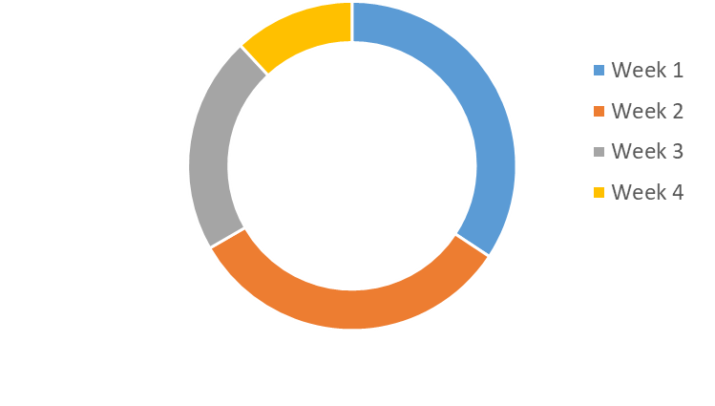
Cutting Material Availability Dashboard – Top Management
Date Range
Plant
2025/07/01
All
Line
Submit
All
📦 Material Readiness %
82% Ready
🚨 Open Escalations (issues not yet resolved)
5
📋 Total POs Today
36
📈 Avg Delay
2.1 days
Purpose: Compare different plants to see which ones are better prepared for cutting.
Description : Shows % of material availability across all assigned POs
Benefits : Identify which plant is performing well and where attention or escalation is needed.
Top 5 Short Materials :
Material | Short Quantity | Affected Pos
FTWR WHITE 01F7 54 | 340m | 3
1.4MM ECO SOFT MATTE | 220m | 8
CEMENT TWICE | 165m | 21
WHITE LATEX | 100m | 4
ST-A990-06E EPM5 MESH | 92m | 1
Purpose: Highlight the most frequently short or unavailable materials, across all POs.
Benefits : Quickly identify which raw materials are causing the biggest disruptions—helps guide procurement priorities
Cutting Availability Trend ( Weekly ) ( Line Wise )
Purpose: Visualize the trend of material readiness over time
Benefits : Spot improvement or decline in readiness over time. A dropping trend might signal deeper issues in supply or coordination.

Slide 8
Mail Escalations And WhatsApp Escalations
Escalation Type | Trigger Condition | Target Department | Medium
Material Shortage Alert | Required material not available in stock & no PO before CRD | Purchase, Warehouse | Email, WhatsApp
Delayed PO Delivery | PO delivery date exceeds CRD or cutting plan date | Purchase | Email, WhatsApp
Cutting Plan at Risk | Material not ready 2 days before scheduled cutting | Planning, Production | WhatsApp
Line Stoppage Notification | Production halted due to missing material | Planning, Purchase, Warehouse | Email
Material Fetch Delay | Material request issued but not fetched from warehouse | Warehouse | WhatsApp
Schedule Escalation | Cutting not started on planned date | Planning | Email

Slide 9
Data Connectivity for Cutting Material Report
Data Transform From SAP to Oracle
SAP System
FMS – ETL Process
Oracle Database
Cutting Material Management Report
Data Flow
FMS runs automatically at a defined time (e.g., Before 11:30 PM daily).
Extracts relevant data (Done Cutting materials) from SAP using T-Code.
Transforms and pushes the data to Oracle DB tables
SAP to Oracle ( Via FMS )
Backend (C# API) queries relevant Oracle tables.
Applies any required business logic (e.g., grouping, filtering, validation).
Oracle to Backend
API exposes endpoints for the Vue.js frontend to consume.
/api/materials/done-cutting.
Supports filtering by date, batch, material type, etc.
Backend to Frontend
Dashboards / Reports showing Done Cutting data.
Features: filtering, searching, exporting to Excel/PDF, pagination
Frontend Vue.js

Slide 10
Track Material Process flow in SAP For One PO
The Material information for SO ( 1000241184 ) from SAP.
Schedule | Sales Order | Order Quantity | Material | BOM Dosage Qty | PURCHASE Quantity | FETCHING Quantity | Fetching Isuue Qty | Fetching Un-issue Qty
2025/06/20 – 2025/06/25 | 1000241164 | 234 | 3100169880 | 2.099 | 21.201 | 2.104 | 2.104 | 0
 |  |  | 4010201784 | 277.43972 | 1,415.70 | 139.658 | 139.658 | 0
 |  |  | 4010400004 | 96.13403 | 510.488 | 51.704 | 51.704 | 0
 |  |  | 4020100305 | 0.8481 | 8.648 | 0.853 | 0.853 | 0
 |  |  | 4020109418 | 2.466 | 25.131 | 2.471 | 2.471 | 0
 |  |  | 4030800019 | 4.1808 | 42.333 | 4.184 | 4.184 | 0
 |  |  | 4040300029 | 468 | No Purchase Data | No Fetching Data | No Data | No Data
 |  |  | 4040402608 | 50 | No Purchase Data | No Fetching Data | No Data | No Data
 |  |  | 4040403276 | 184 | No Purchase Data | No Fetching Data | No Data | No Data
 |  |  | 4040600043 | 14.1904 | 142.619 | 14.201 | 14.201 | 0
 |  |  | 4040600041 | 28.7144 | 399 | 28.723 | 28.723 | 0

Slide 11
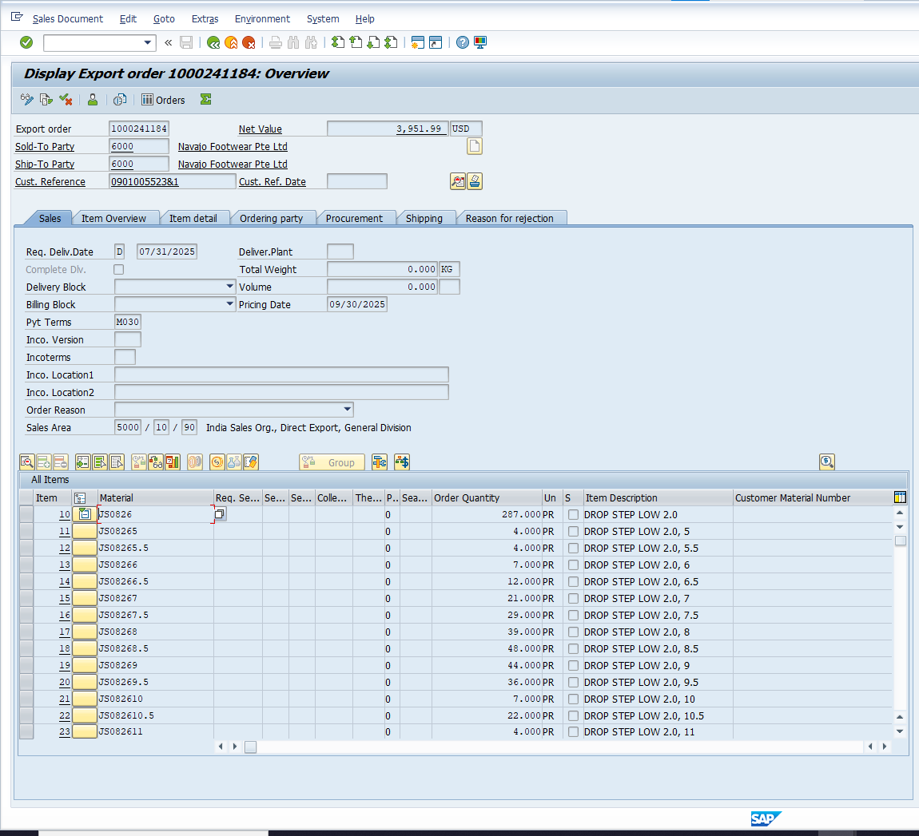
Sales Order Data Capture From SAP
This slide presents the extraction of key order information directly from SAP for reference and processing.
Displays the complete order overview, including customer information, and delivery details.
T-Code : VA03
SO Details :
Sales Order : 1000241184
Sales Order Total Quantity : 287
Material : 3100160891

Slide 12
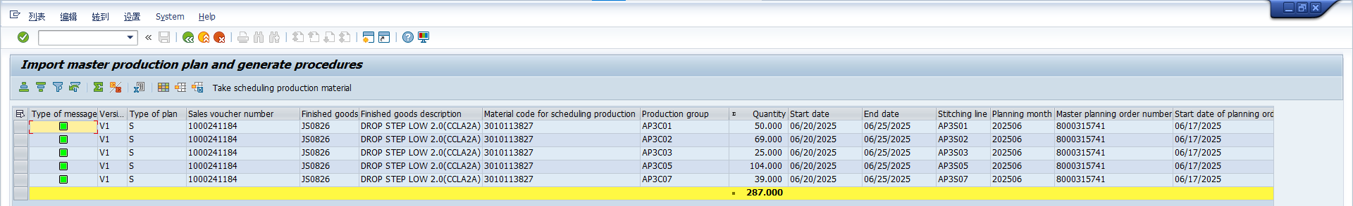
Planning Schedule Data Capture From SAP
This slide presents the planning schedule dates for a Sales order.
T-Code : ZPP003
SO Details :
Sales Order : 1000241184
Sales Order Total Quantity : 287

Slide 13
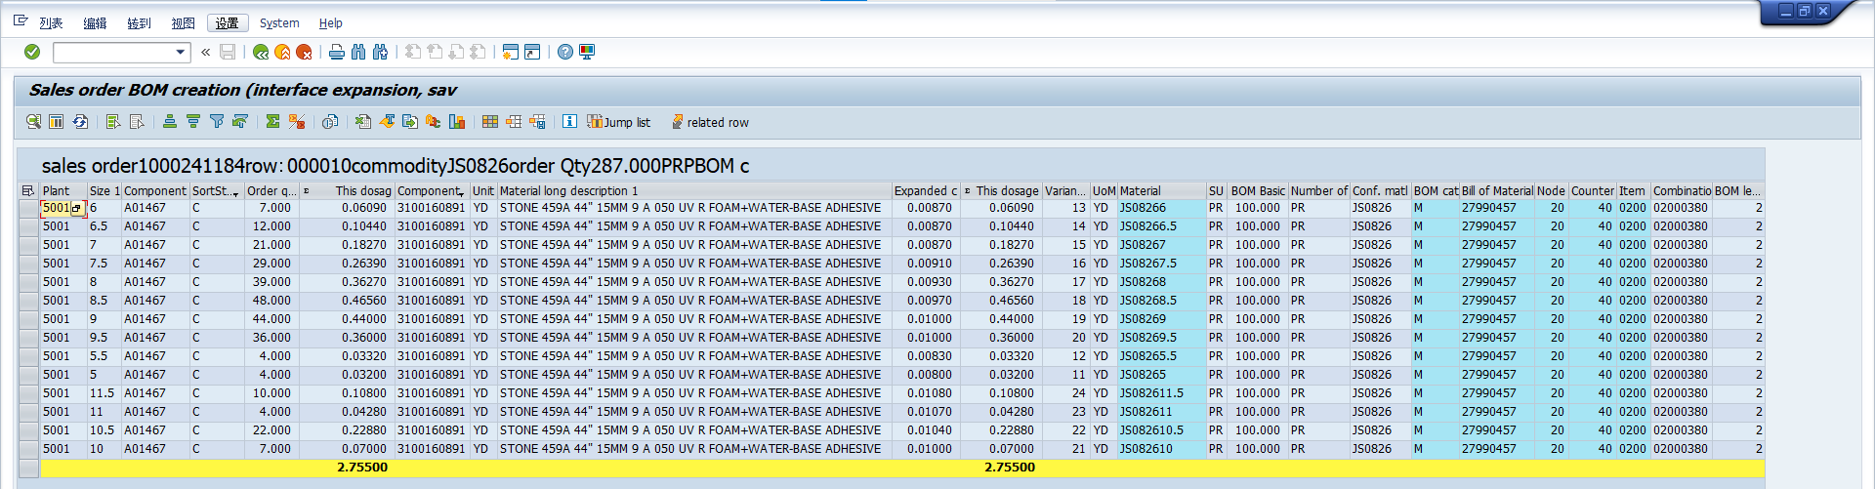
BOM Data Capture From SAP
This slide provides a summary of the total dosage quantity for one specific material.
Displays the complete BOM overview with total dosage quantity for cutting material only using the t-code ( ZMM123 )
SO Details :
Sales Order : 1000241184
Sales Order Total Quantity : 287
Material : 3100160891

Slide 14
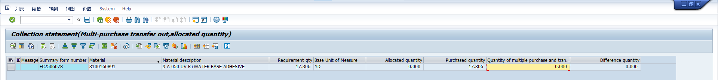
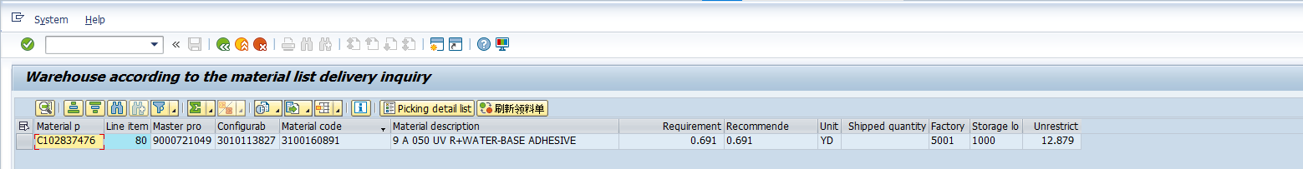
PURCHASE Data Capture From SAP
The Requirement quantity and allocated quantity and purchase quantity of material using t-code ( ZMM017_BB )
SO Details :
Sales Order : 1000241184
Sales Order Total Quantity : 287
Material : 3100160891
FETCHING Data Capture From SAP
The Fetching Details for material using t-code ( ZPP005B )
SO Details :
Sales Order : 1000241184
Sales Order Total Quantity : 287
Material : 3100160891

Slide 15
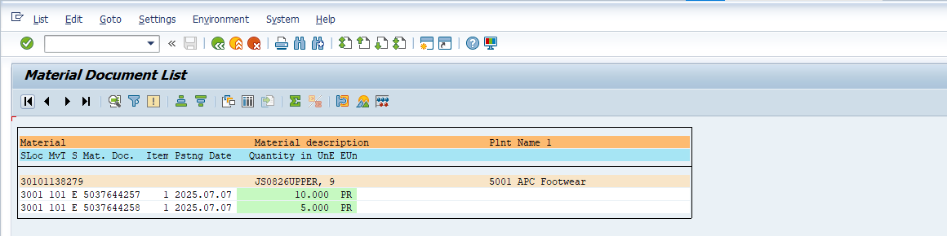
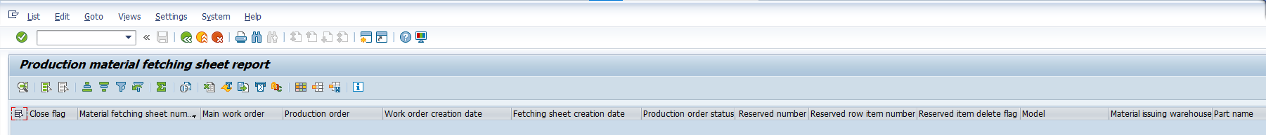
WAREHOUSE STOCK Data Capture From SAP
The warehouse stock for upper Material using the t-code ( MB51 )
The material information using the t-code ( ZMM113 )

Slide 16




